Slide 1
SMART ASSISTIVE ATM SYSTEM FOR
BLIND AND VISUALLY IMPAIRED USERS
BY:
Kavya. A.J - 311621106013
Neha. L - 311621106022
Priya. R - 311621106026
GUIDE:
Ms. P. Lavanya – ASP/ECE

Slide 2
OBJECTIVE:
To develop a smart ATM that enables visually impaired individuals to perform banking transactions independently.
Utilize OpenCV-based computer vision to enhance accessibility and interaction for blind users.
Implement step-by-step guidance, audio feedback, and haptic interfaces to ensure seamless navigation.
Promote financial inclusion by breaking barriers and ensuring equal access to banking services.
Design an intuitive and user-friendly interface tailored specifically for blind users.
Reduce reliance on third-party assistance, fostering confidence and independence in financial transactions.
Encourage banking institutions to adopt smart ATMs and support accessible banking practices.

Slide 3
ABSTRACT:
The “Breaking barriers smart ATM with OpenCV for blind users" aims to revolutionize accessibility in banking services by developing an innovative automated teller machine (ATM) that caters specifically to individuals with visual impairments.
This groundbreaking technology utilizes the power of OpenCV (opensource computer vision) to provide an inclusive and user-friendly interface, enabling blind users to independently perform banking transactions. The integration of OpenCV technology enables the ATM to adapt to the unique needs of each user group, delivering a personalized and accessible banking experience.
By breaking down barriers and empowering individuals with disabilities, the smart ATM aims to promote financial inclusion and equal access to banking services for all.
The abstract outlines the vision and key features of the breaking barriers smart ATM, highlighting its potential to transform the way individuals with visual impairments interact with automated banking systems.
Additionally, the system provides step-by-step guidance to assist blind users, the smart ATM employs audio feedback and haptic interfaces, allowing them to navigate through menus and transaction options effortlessly.

Slide 4
LITERATURE SURVEY:
Author and Title | Year & Journal | Outcome of the Research
Fingershield ATM – ATM Security System using Fingerprint Authentication. Authors: Christiawan , Bayu Aji Sahar, Azel Fayyad Rahardian Elvayandri Muchtar. | October 2018 (ISESD). | ATM fraud, particularly skimming, leads to significant financial losses in Indonesia. The proposed Finger Shield ATM uses fingerprint biometrics integrated with smart cards for enhanced security.
Optimal ATM Cash Replenishment Planning in a Smart City using Deep Q-Network. Authors: Mohammadhossein Kiyaei. | (CSICC) in 2021. | ATMs, now part of IoT, require efficient cash management, especially during COVID-19.A Double Deep Q-Network (DQN) model is used to optimize cash replenishment under dynamic demand
Gokul,S.,Kukan,S.,Meenakshi K.,Vishnu Priyan S.,Rolant Gini J.,M.E.Harikumar–"Biometric Based Smart ATM Using RFID" | (ICSSIT) on August 1, 2020. | This system proposes a smart ATM using RFID and fingerprint authentication for enhanced security. It alerts users with location, time, and authorization status, and includes vibration, flame sensors, and camera monitoring.
Secure Authentication for ATM transactions using NFC technology. Authors: Divyans Mahansari, Uttam Kumar Roy | (ICCST) in October 2019. | This system replaces traditional ATM cards with smartphones using NFC Card Emulation for transactions. Users authenticate by swiping their phone near the NFC reader, reducing risks like skimming and card damage.
Real-Time ATM Cash Replenishment Model M. Mohamed Idhris, et al | March 2017-IJETT | This paper addresses real-time ATM cash replenishment under outflow uncertainty, considering increased fees on weekends/holidays.

Slide 5
Author and Title | Year & Journal | Outcome of the Research
Smart ATM Service. Authors: Sayan Hazra | 2019 in (DevIC) | This study proposes an Internet of Things (IoT) and Computer Vision-based Smart ATM service utilizing a Raspberry Pi microcontroller-based embedded system. The system aims to enhance ATM security and efficiency by integrating advanced technologies, thereby improving the user experience and safeguarding against fraudulent activities. ​
Paschal A. Ochang and Paulinus O. Ofem, "An Enhanced Automated Teller Machine Security Prototype using Fingerprint Biometric Authentication | 2017, in (IJANA). | This study analyzes and proposes a biometric authentication prototype that integrates fingerprint security with ATMs as an additional security layer. The prototype combines fingerprint biometric techniques with personal identification numbers (PINs) to enhance security.
Joseph B. Awotunde , Tolorunloju R. James, Suhurat I. Abdulkadir, and Fatimoh T. Adewunmi-Owolabi, "Fingerprint Authentication System: Toward Enhancing ATM Security"​ | 2014, in (IJAIS) | The paper addresses the limitations of PIN-based ATM security by introducing fingerprint authentication. A prototype ATM system was designed to use fingerprint identification for enhanced security. The system features a three-tier architecture involving fingerprint enrollment, enhancement, feature extraction, and matching.
Kohbalan Moorthy, Kauthar Mohd Daud, Steven R. Arokiasamy, and Md Raihanul Islam Tomal, "Hybrid Biometric Authentication for Automatic Teller Machine"​ | 2024,in ​(IJSECS) | The research introduces a hybrid biometric authentication system for ATMs, focusing on fingerprint recognition. The prototype aims to enhance transaction security and provide a more user-friendly experience by integrating biometric strategies with ATMs for single verification.
Shivam Kumar Rajput, Aniket R. Patne, Amit Varma, and Girish Vishe, "Enhanced Fingerprint Recognition and OTP to Improve ATM Security" | 2019, in ​​(IJARIIT) | This study proposes enhancements to ATM security by integrating fingerprint recognition and a One-Time Password (OTP) system. The approach involves using a fingerprint module and sending a unique 4-digit OTP to the user's registered mobile number via a GSM module.

Slide 6
EXISTING SYSTEM
Traditional ATMs rely on visual interfaces (touchscreens, keypads, and card slots).
Users must read on-screen instructions and input data manually.
Limited accessibility features for visually impaired individuals.
Some ATMs have Braille keypads, but they lack interactive guidance.
Dependence on third-party assistance compromises privacy and independence.

Slide 7
DEMERITS OF THE EXISTING SYSTEM
Lack of Accessibility: ATMs are primarily designed for sighted users.
Privacy Concerns: Users may need assistance from others, risking security.
Limited Feedback: Braille keypads provide minimal interaction, lacking voice guidance.
Complex Navigation: No intuitive interface tailored for visually impaired users.
Risk of Fraud: Dependence on others increases vulnerability to financial fraud.

Slide 8
PROPOSED SYSTEM
Computer Vision Integration: Uses OpenCV to recognize gestures and provide interactive guidance.
Speech Synthesis: The ATM provides step-by-step voice instructions to guide users through each transaction.
Audio & Haptic Feedback: Ensures seamless navigation through menus and transactions.
Personalized Banking Experience: Adapts to individual needs for enhanced accessibility.
Increased Independence & Security: Empowers users to conduct transactions securely.

Slide 9
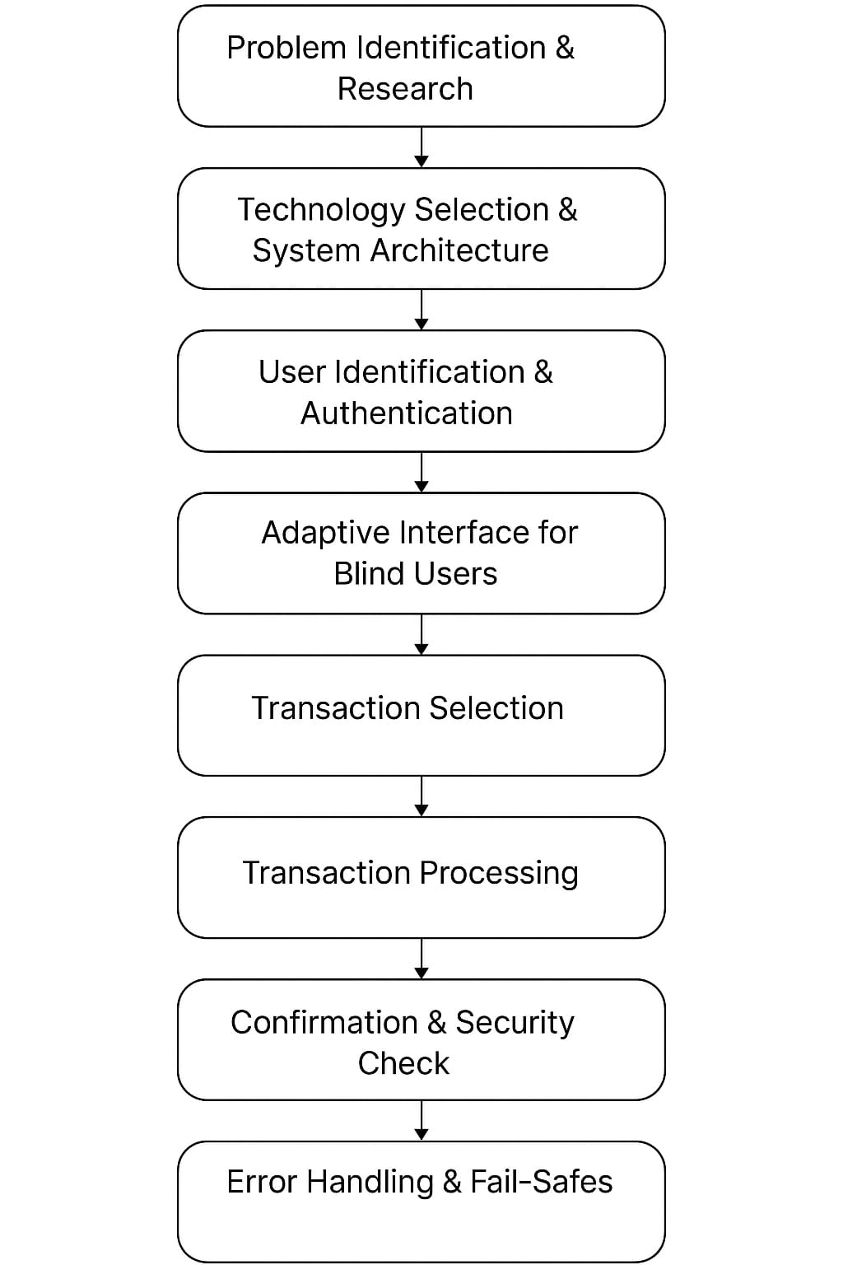
FLOW DIAGRAM

Slide 10
BLOCK
DIAGRAM:
POWER SUPPLY
ARDUINO MEGA
LCD
SERVO MOTOR
(6)
PUSH BUTTON (11)
DF PLAYER
RS232 MODULE
SPEAKER
OPEN CV
(Face detection)

Slide 11
CIRCUIT DIAGRAM

Slide 12
HARDWARE DESCRIPTION:
ATmega 2560 Microcontroller (Arduino Mega):
Can store and run a program written in Embedded C.
Has many input/output pins to connect buttons, LCD, etc.
Can store and run a program written in Embedded C.
Uses a USB connection for uploading code through Arduino IDE.
Power Supply:
It gives electrical power to all components in the project.
Supplies 12V DC power to the circuit.
Powers the microcontroller, LCD, DF Player, etc.
DF Player Mini (MP3 Module) :
It plays audio messages to guide the blind user.
Plays pre-recorded voice instructions from a microSD card.
Connects to speaker for audio output.

Slide 13
Push Button:
It lets the user interact with the system by pressing.
Used for inputs like confirming or cancelling actions.
Sends a signal to Arduino when pressed.
Servo Motor:
Controlled by Arduino using a PWM signal.
Can rotate from 0° to 180°.
Responds to instructions quickly and accurately.
Servo Driver:
A module or IC that controls one or more servo motors.
Controls up to 16 servos independently.

Slide 14
LCD Display:
It shows text on the screen for sighted users or developers.
Displays messages like "Welcome" or "Transaction Done".
Helpful for developers to see the system status.
Makes the system more user-friendly for all.
Speaker:
Produces sounds like "Enter your PIN" or "Transaction Successful".
Small and compact, fits inside the ATM unit.
Clear audio makes it easy to follow steps.
Provides real-time audio feedback.
RS232 Module:
RS232 is a way for two electronic devices to talk to each other using wires, like the Arduino Mega and a printer or computer.

Slide 15
SOFTWARE DESCRIPTION:
Embedded C
A programming language used to control hardware.Helps write instructions for the microcontroller.Allows you to turn on/off pins and read inputs.Used for real-time actions like reading buttons or moving motors.Very fast and works close to the hardware.Runs the logic that powers your ATM functions.Handles conditions like “if card inserted, then speak.”Used to control timing, like delays or motor rotation.Written in a structured format for better readability.Works with Arduino internally since Arduino uses C/C++.
Arduino IDE
Software used to write and upload code to Arduino boards.Very easy to use for beginners.Allows you to type code, verify it, and send it to your microcontroller.Comes with many built-in examples and libraries.Can control devices like LCDs, servos, and MP3 players.Has a Serial Monitor to see what your board is doing.Used to test and run your project step-by-step.Supports libraries like DFPlayerMini, Servo, etc.Can help debug the system if something doesn’t work.Works on Windows, macOS, and Linux. 3. Python (Simple Explanation)A high-level programming language, easy to learn.Used in your project for simulation or backend processing.Can communicate with Arduino using USB (via serial port).Helpful for creating simple apps or ATM interfaces.Can generate voice outputs using TTS (text-to-speech).Stores user data like transactions or inputs.Can connect with a database to simulate ATM balance check.Used for testing how the hardware behaves.Good for writing short scripts to control your project.Adds intelligence and interaction to your system

Slide 16
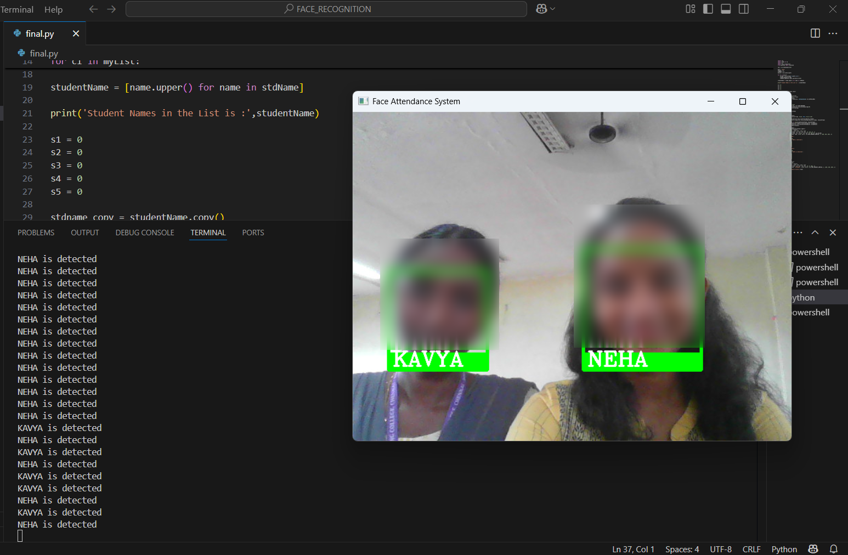
SIMULATION RESULTS :

Slide 17
HARDWARE REQUIREMENTS:
Power Supply
Arduino Mega
Push Button
Servo Motor
Servo Driver
DF Player
Speaker
LCD
SOFTWARE REQUIREMENTS:
Arduino IDE
Embedded C
Anaconda Navigator

Slide 18
REFERENCE:
[1] Yaoguo Li, Huiye Sun, Chen Zhang, and Guohui Li, “Sites selection of atms based on particle swarm optimization,” in 2009 International Conference on Information Technology and Computer Science. IEEE, 2009, vol. 2, pp. 526–530.
[2] Valeria Platonova, Elena Gubar, and Saku Kukkonen, “Heuristic optimization for multi-depot vehicle routing problem in atm network model,” in Advances in Dynamic Games, pp. 201–228. Springer, 2020.
[3] Mithat Zeydan and Sümeyra Kayserili, “A rule-based decision support approach for site selection of automated teller machines (atms),” Intelligent Decision Technologies, vol. 13, no. 2, pp. 161–175, 2019.
[4] Fazilet Ozer, Ismail Hakki Toroslu, Pinar Karagoz, and Ferhat Yucel, “Dynamic programming solution to atm cash replenishment optimization problem,” in International Conference on Intelligent Computing & Optimization. Springer, 2018, pp. 428–437.
[5] ¸Seyma Batı and Didem Gözüpek, “Joint optimization of cash management and routing for new-generation automated teller machine networks,” IEEE Transactions on Systems, Man, and Cybernetics: Systems, 2017.

Slide 19
[6] Canser Bilir and Adil Dö¸seyen, “Optimization of atm and branch cash operations using an integrated cash requirement forecasting and cash optimization model,” Business & Management Studies: An International Journal, vol. 6, no. 1, pp. 237–255, 2018.
[7] Soodabeh Poorzaker Arabani and Hosein Ebrahimpour Komleh, “The improvement of forecasting atms cash demand of iran banking network using convolutional neural network,” Arabian Journal for Science and Engineering, vol. 44, no. 4, pp. 3733–3743, 2019.
[8] Sarveswararao Vangala and Ravi Vadlamani, “Atm cash demand forecasting in an indian bank with chaos and deep learning,” arXiv preprint arXiv:2008.10365, 2020.
[9] S Poorzaker Arabani and H Ebrahimpour Komleh, “The optimization of forecasting atms cash demand of iran banking network using lstm deep recursive neural network,” Journal of Operational Research In Its Applications (Applied Mathematics)-Lahijan Azad University, vol. 16, no. 3, pp. 69–88, 2019.
[10] Hossein Abbasimehr, Mostafa Shabani, and Mohsen Yousefi, “An optimized model using lstm network for demand forecasting,” Computers & Industrial Engineering, p. 106435, 2020

Slide 20
THANK YOU

